Slide 1
Create and Maintain Business Master Data Workshop A-1 Jose Diaz and Mohanta Das 5/6/26

Slide 2





Overarching Design Principles
Fit to Standard
SAP First
We will change and adapt our existing business processes to fit to standard ‘out of the box’ functionality.
We will adopt an “SAP first” strategy with all financial and operational data housed within SAP.
Minimize customizations
‘Best of Breed’ by exception
Non-SAP applications will only be considered if they are considered ‘best of breed’ and are necessary to enable competitive advantage or meet complex regulatory requirements.
We will minimize customizations and keep the core clean to ease future upgrades, improving agility and scalability.
Rationalize Applications
We will standardize and rationalize our applications to control costs and reduce the complexity of our IT estate.

Slide 3




WORKSHOP OBJECTIVES AND OUTCOMES
OBJECTIVES
Confirm As-Is Process maps to future state
Define BMD Process Procedures
Identify key data, reporting and cross-functional requirements
OUTCOMES / INPUTS TO DELIVERABLES
Updated User Story / Task in Azure DevOps
Documented Change Impacts
Identified gaps / WRICEFs
Understand Remediation Scope
GROUND RULES
In Person
Virtual
Start and End the workshop on time
Please keep side conversations to a minimum
Questions are encouraged
Try not to use acronyms (when possible)
Unmute yourself to speak, and then mute immediately after
All questions to be posted in the meeting chat
Ensure that everyone has their cameras on when possible
Please allow time for breaks
Cell phones, laptops, and tablets switched off
Please ensure your understanding
Resist the temptation to multitask
If background noise hand off to a colleague and mute to reestablish your environment
Use the “raise hand” feature to ask questions
For troubleshooting, individually contact the host (Scrum Master)

Slide 4
Workshop Agenda*
TOPIC
01
Purpose
Current State Assumptions
Master Data Design
Open Questions
FRICEF-W List
Data Migration
Security Roles
Key Decisions, Action Items, Change Impacts, Wrap-Up, and Next Steps
02
03
04
05
06
07
08

Slide 5
01 Purpose

Slide 6
Purpose
Define the target-state ownership, master data design, required fields, and key process dependencies.
Ownership
Data Design
Required Fields
Key Processes

Slide 7
Ownership
Object | Teams Impacted | Business Process Owner | Reviewers
Business Partner | Customer | Dawn, Tarah | Shibu
Contract Account | Customer, Finance, Supply Chain | Dawn, Tarah | Shibu
Contract

Slide 8
02 Current State Assumptions

Slide 9
Assumptions for Future State
CRM only consumes 2 numbers ranges bidirectionally
Vendors are not required in CRM
BP Creation from CRM creates MKK Contract Partner Role in ECC
BP Creation from CRM creates BP Grouping 0003 CRM BP’s ID in ECC
BP created from CRM creates a customer in KNA1
DQM does not validate Street 3.
It is utilized as the PO Box details
No | From No | To No | Ext | Grouping | Short Name | Description | Number Range
01 | 1000000000 | 1029999999 |  | 0001 | ECC BP's | BP's Created in ECC | 01
02 | 1030000000 | 1999999999 | X | 0003 | CRM BP's | BP's Created in CRM | 02

Slide 10
03 Master Data Design

Slide 11
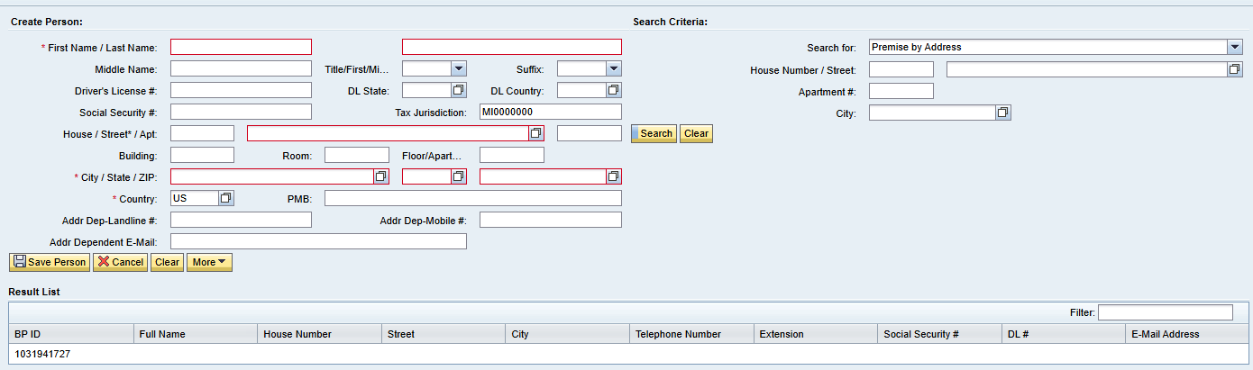
Create Person BP in CRM
Field | Mandatory | Optional | Defaulted | Field | Mandatory | Optional | Defaulted
First Name | X |  |  | Apartment |  | X
Last Name | X |  |  | Building |  | X
Middle Name |  | X |  | Room |  | X
Title |  | X |  | Floor |  | X
Suffix |  | X |  | City | X
Drivers License # |  | X |  | State | X
Drivers License State |  | X |  | Zip Code | X
Drivers License Country |  | X |  | Country | X |  | X
Social Security # |  | X |  | PMB |  | X
Tax Jurisdiction | X |  | X | Address Dependent Landline # |  | X
House |  | X |  | Address Dependent Mobile # |  | X
Street | X |  |  | Address Dependent Email |  | X

Slide 12
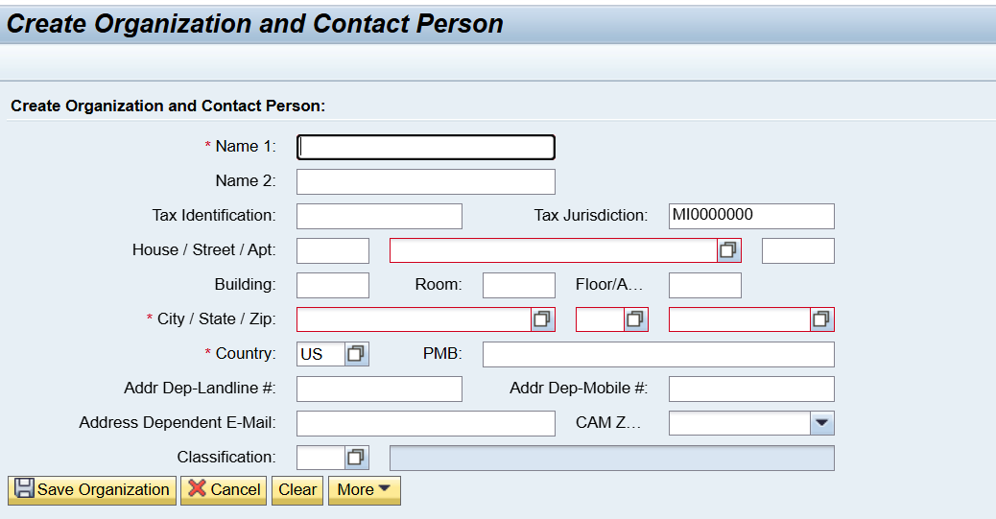
Create Organization BP in CRM
Field | Mandatory | Optional | Defaulted | Field | Mandatory | Optional | Defaulted
Name 1 | X |  |  | Zip Code | X
Name 2 |  | X |  | Country | X |  | X
Tax Identification |  | X |  | PMB |  | X
Tax Jurisdiction | X |  | X | Address Dependent Landline # |  | X
House |  | X |  | Address Dependent Mobile # |  | X
Street | X |  |  | Address Dependent Email |  | X
Apartment |  | X |  | CAM Zone |  | X
Building |  | X |  | Classification |  | X
Room |  | X
Floor |  | X
City | X
State | X

Slide 13
Maintain Person BP in CRM
Field | Mandatory | Optional | Defaulted | Field | Mandatory | Optional | Defaulted
First Name | X |  |  | Apartment |  | X
Last Name | X |  |  | Building |  | X
Middle Name |  | X |  | Room |  | X
Title |  | X |  | Floor |  | X
Suffix |  | X |  | City | X
Drivers License # |  | X |  | State | X
Drivers License State |  | X |  | Zip Code | X
Drivers License Country |  | X |  | Country | X |  | X
Social Security # |  | X |  | PMB |  | X
Tax Jurisdiction | X |  | X | Address Dependent Landline # |  | X
House |  | X |  | Address Dependent Mobile # |  | X
Street | X |  |  | Address Dependent Email |  | X

Slide 14
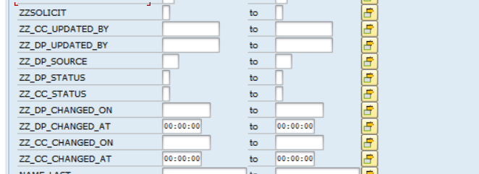

Slide 15
Maintain Organization BP in CRM
Field | Mandatory | Optional | View Only | Field | Mandatory | Optional | View Only
Full Name |  |  | X | Info release |  | X
ID |  |  | X | No auto credit transfer |  | X
First Name | X |  |  | BCC Dunning Hold |  | X
Last Name | X |  |  | BCC Shut-Off Notice Suppression |  | X
Title |  | X |  | CC Status |  |  | X
Middle Name |  | X |  | Date/Time |  |  | X
Suffix |  | X |  | CC Updated By |  |  | X
Driver's License |  | X |  | CC Source |  |  | X
SSN |  | X |  | DP Status |  |  | X
DL State |  | X |  | Date/Time |  |  | X
DL Country |  | X |  | DP Updated By |  |  | X
Classification |  | X |  | DP Source |  |  | X
Employee Classification |  | X |  | People in Household |  | X
Date of Birth |  | X |  | Payment Frequency |  | X
Job Title |  | X |  | Household Income |  | X
Do Not Solicit – VAPS |  | X |  | Updated Date |  |  | X
No auto credit transfer |  | X |  | Source |  |  | X

Slide 16
Create Person BP in ECC

Slide 17
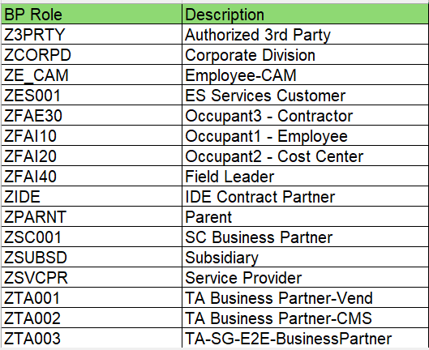
BP Roles

Slide 18
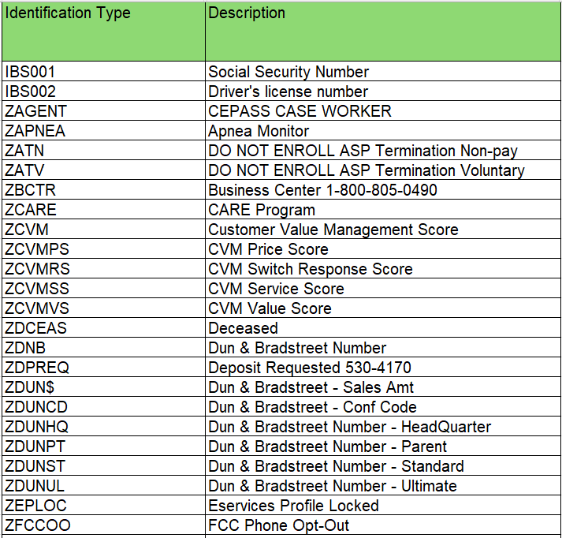
BP ID Types
IBS001 | Social Security Number | ZCVMSS
IBS002 | Driver's License Number | ZCVMVS
ZAGENT | CEPASS CASE WORKER | ZDCEAS
ZAPNEA | Apnea Monitor | ZDNB
ZATN | DO NOT ENROLL ASP TERMINATION Non-pay | ZDPREQ
ZATV | DO NOT ENROLL ASP TERMINATION Voluntary | ZDUN$
ZBCTR | Business Center 1-800-805-0490 | ZDUNCD
ZCARE |  | ZDUNHQ
ZCVM |  | ZDUNPT
ZCVMPS |  | ZDUNST
ZCVMRS |  | ZDUNUL

Slide 19
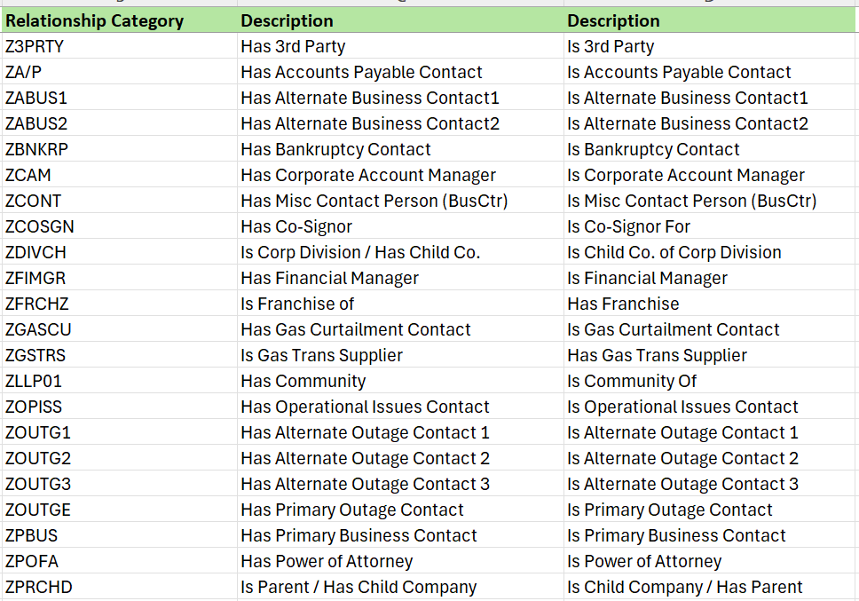
BP Relationships

Slide 20
Titles

Slide 21
Name Prefix

Slide 22
04 Open Questions

Slide 23
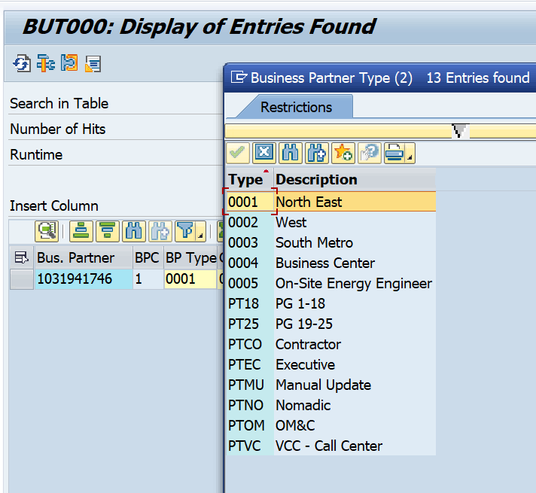
Key Open Question
Moving forward will Consumers continue to utilize Street 3 instead of PO Box fields?
How is the BP Type getting determined ? What is this value being used for?
Custom SSN and Driver's license field. What was the intention of this and not using standard ?

Slide 24
05 FRICE-W

Slide 25
FRICEF-W Identified
Telephone number format and length validation
ID Masking
ID types format and length validation
Drivers License format and length
Social Security format and length
DQM address validation
Business Partner Field Enhancements (Custom fields)

Slide 26
06 Data Migration

Slide 27
Potential Tables
CRMD_ACTIVITY_H
CRM_ORDERADM_H
CRM_ORDERADM_I
CRMV_LINKPARTNER

Slide 28
07 Security Roles

Slide 29
Provided by CE Customer Team

Slide 30
08 Key Decisions, Action Items, Change Impacts, Wrap-Up & Next Steps

Slide 31
Program Charging (CE Internal Only)
The Change & Why:
We need to track O&M costs more precisely. OCM and Data Conversion must be charged separately from End User Training and from Design/Build/Deployment work. This change is retroactive from February for Accounting, Rate case discovery, and audit.
Ask:
Pls follow the instructions below that apply to you based on your staffing category on the LaunchPad program. It is critical to track costs in the correct cost buckets.
Business Partner (BP) Core Team (Use SAP*):
Continue 100% allocation as before. (BP&A handles this automatically behind the scenes and no time entry is needed except for the two scenarios below)
Submit time only for OCM and Data Conversion activities; Use SAP to bill IO 6520973.
Submit time only for End User Training; Use SAP to bill IO 6519532.
IT Core Team (Use Clarity):
S4- Customer – Design/Development/Testing/Deploy Clarity Task
Clarity Timesheets will now be used for time charging, and the allocation mechanism is discontinued. Submit timesheets from February 2nd for a one-time catchup.
Separate tasks for OCM, End User Training, and Data Conversion are available; Find them using keywords OCM, End User Training, and Data Conversion and charge them as applicable.
Extended BP Team (use SAP*):
Bill SAP IO 6520973 for OCM and Data Conversion.
Bill SAP IO 6519532 for End User Training.
Use new IO 6521411 for all other tasks.
Extended IT Team (Use Clarity):
S4- Customer – Design/Development/Testing/Deploy Clarity Task
Bill specific tasks for OCM, End User Training, and Data Conversion; ID the tasks using the keywords OCM, End User Training, and Data Conversion.
Bill other tasks as appropriate.
*SAP Timesheet Submission Instructions (for BPs)
Follow ESS steps (screen shot below): 1. Open ESS timesheet. 2. Enter IO number in work order field. 3. Select WORK code under ATT-ABS. 4. Add OCM, End User Training, or Data Conversion in comments. 5. Enter hours worked.

